Slide 1
Systems & Software Security COMSM0050 2020/2021

Slide 2
Intel SGX

Slide 3

Rootkit high-level understanding
applications
libraries
data
User space
operating system
Kernel space
bad code
hardware

Slide 4
Motivation
An attacker can compromise
User space
Operating Systems
Even the hardware!
What can we do?

Slide 5
Motivation
An attacker can compromise
User space
Operating Systems
Even the hardware!
What can we do?
Execute code in its own secure enclave!

Slide 6
SGX Hardware supported enclave
WARNING: there is vulnerabilities in SGX

Slide 7
SGX Hardware supported enclave
WARNING: there are vulnerabilities in SGX
Idea: run an application within some isolation unit so it cannot be affected by the OS
don’t trust the OS or the VMM/hypervisor
only need to trust the hardware

Slide 8
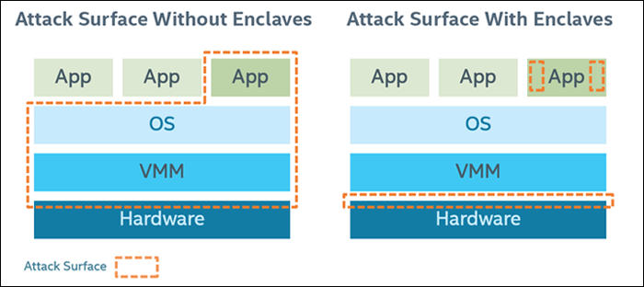
SGX Hardware supported enclave
WARNING: there is vulnerability in SGX
Idea: run an application within some isolation unit so it cannot be affected by the OS
don’t trust the OS or the VMM/hypervisor
only need to trust the hardware
reduce attack surface

Slide 9
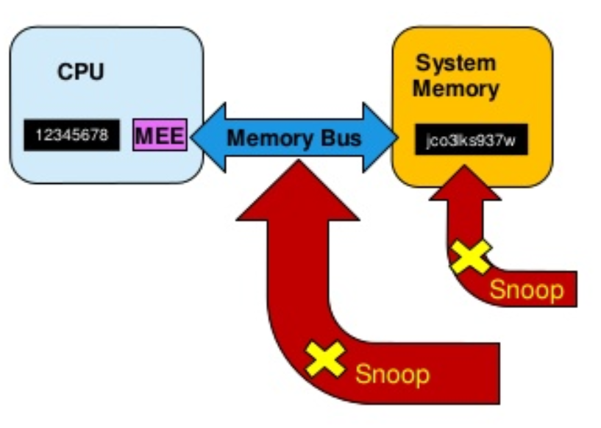
SGX preventing memory snooping attack
* MEE: SGX Memory Encryption Engine
Security boundary is CPU package
Data unencrypted inside the CPU
Data outside the CPU is encrypted
External memory reads and bus snooping only see encrypted data

Slide 10
SGX Programming environment
OS
App Data
App Code
User Process

Slide 11
SGX Programming environment
OS
Enclave
App Data
App Code
User Process

Slide 12
SGX Programming environment
OS
Enclave Stack
Enclave has its own code and data
Provide confidentiality
Provide integrity
Controlled entry point
Can enter enclave code only at specific point
Enclave execution takes over
Enclave Heap
Enclave
Enclave Code
App Data
App Code
User Process

Slide 13


Memory protection
RAM
enclave
CPU
MEE
other SW
malware
OS

Slide 14
SGX Application Flow
Call Bridge
Define and partition application into trusted and untrusted part
App create enclave
Trusted function is called
Code in enclave process some secret
Trusted function returns
App continue as normal
2. Create Enclave 3. Trusted() 6. Continue
4. Process Secret 5. Return

